Slide 1
Chap 3: Control flow
Lecture 1: Decision making and branching
Notes:
we are going talk about

Slide 2
Introduction
Two-way branching —— The simplest decision making
if (bank balance is zero) borrow money
if (room is dark) turn on lights
if (age is more than 60)
person is retired
C language possesses such decision-making capabilities by supporting the following statements
if statement
switch statement
Conditional operator statement
goto statement
Entry
test expression?
False
True
Notes:
control flow statements are loops and conditionals anything that can branch our program and
the foundation for more complex applications
so literally you're going to see these in every application
if you don't know what these are you better get used to them

Slide 3





Flowchart
Flow
Lines represent the flow of the sequence and direction of a process.
What is a Flowchart?
A flowchart is a graphical representations of steps.
Nowadays, flowcharts play an extremely important role in displaying information and assisting reasoning.
They help us visualize complex processes, or make explicit the structure of problems and tasks.
Flowchart Symbols
Data
It represents information entering or leaving the system. An input might be an order from a customer. Output can be a product to be delivered.
Decision
A diamond represents a decision or branching point. Lines coming out from the diamond indicates different possible situations, leading to different sub-processes.
Terminator
The terminator symbol represents the starting or ending point of the system.
Process
A box indicates some particular operation.
Document
This represents a printout, such as a document or a report.

Slide 4
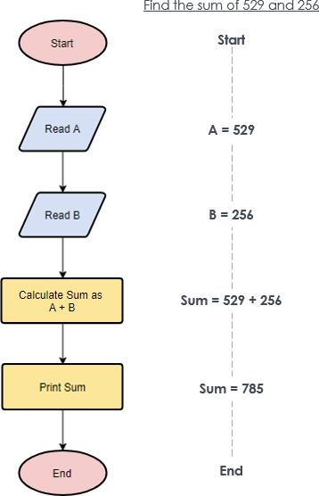
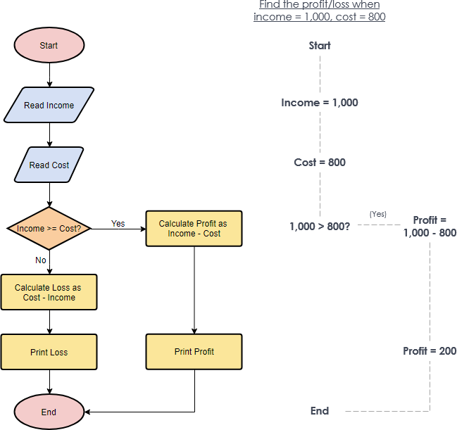
Flow chart

Slide 5
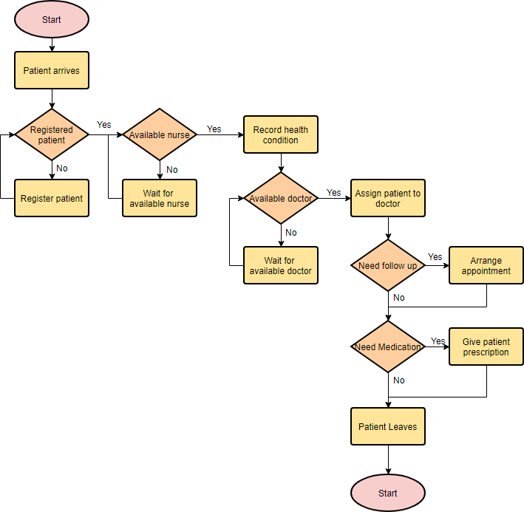

Slide 6
Simple if statement
Relational and/or logical expressions
Non-zero stands for true, otherwise false
General form
Flow chart
if (test expression)
{
//code
//statement-block;
}
statement-x;
conditional
Entry
True
test expression?
statement-block
False
statement-x
Notes:
put a left parenthesis and you leave some space because we're gonna put some stuff in there and we close it with a right parenthesis
a left curly brace and then a right curly brace and then inside of here you can put your code .
//forward slashes so now that we know what these characters are called
we just kind of describe what's going on here inside of these curly braces . if ( expression)
we are going to put an expression and if you remember from the previous lecture what's going to happen is that this expression gets evaluated
and it's going to evaluate to true or false so this is a boolean['bu:liən] expression if the expression evaluates to true
we are going to execute everything within these curly braces
if it's evaluated to false we are going to skip curly braces and continued the
evaluation of the code beyond these curly braces
so just so you know this is often called a conditional n. 条件句；条件语
the reason it's called a conditional is because this code here only executes if a certain condition is met
in that condition is this expression being true
and we will be going into some examples in C programming but for now we're just trying to get the concept down.so you really understand what's going on here

Slide 7
Test expressions
Relational or logical operators that having Boolean values
Leap year
Arithmetic expressions of which the value stand for true
Examples:
Assignment expressions can also be tested
The difference of operators = and ==
if ( a - b ) printf("%d != %d", a, b );
if( num% 2) printf("% odd number");
if (sum = a + b) printf("Summation is non-zero");
if ( disc==0 ) if ( disc=0 )
printf(“Two equal roots”);
Notes:
if statement expects a boolean we can pass in a boolean variable
we are going to focus on just a little bit more details and some variations on the expressions that we put inside of the if statement
so we can just kind of get a better feel for the if statement that's because literally the if statement will be in every program you write probably so the first
thing I always do

Slide 8
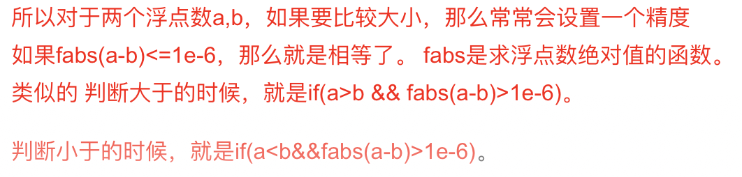
Notes:
Supplementary explanation how to compare the size of two float Numbers
The absolute value绝对值
When judging greater than sign
small number

Slide 9
Exercise 3. 1
A program reads 4 values a, b, c, d from the keyboard and evaluates the ratio of (a+b) to (c-d) and prints the result,
if (c-d) is no equal to zero.

Slide 10
Program
main()
{
int a, b, c, d;
float ratio;
// Read four integer values
printf(“Enter four integer values\n”);
scanf(“%d %d %d %d”, &a, &b, &c, &d);
// Evaluate the ratio
if(c-d !=0) // Is this test correct?
{
ratio=(float)(a+b)/(float)(c-d); //Is type casting necessary?
printf(“Ratio =%f\n”, ratio);
}
}

Slide 11
De Morgan’s Rule
Remove the parentheses by applying the NOT operator to every relation expression component, while complementing the logical operators.
Examples:
!(x&&y||!z)
Apply NOT operators: !x, !y, z
Complement relational operators: !x || !y && z
!(x<=0||!condition)
Leap year: exactly divisible by four is a leap year, except for years that are exactly divisible by 100, but these centurial years are leap years if they are divisible by 400.
(year％4==0 && year％100!=0) || year％400==0
Common year
! (year％4==0 && year％100!=0 || year％400==0)
year%4 != 0 || year%100 == 0 && year %400 != 0
x>0&&condition

Slide 12
If-else statement
General form
if (test expression)
{
True-block statement(s)
}
else
{
False-block statement(s)
}
statement-x
Flow chart
Entry
test
expression
True
False
True-block statement
False-block
statement
statement-x
Notes:
we are going to be talking about the else clause
brackets and move anything that you only want to happen if you lost into the else section

Slide 13
If-else and multiple Ifs
Count the number of boys and girls in a class. We use code1 for a boy and 2 for a girl.
...............
...............
if (code==1)
boy=boy+1;
if (code==2)
girl=girl+1;
...............
...............
...............
...............
if (code==1)
boy=boy+1;
else
girl=girl+1;
...............
...............

Slide 14
Enter the three Numbers a,b, and c, and output them in the order from smallest to largest。
n
a>b
if a>b 将a和b对换
if a>c 将a和c对换
if b>c 将b和c对换
n
y
a>c
y
b>c
y
a和b交换
a和c交换
c和b交换

Slide 15
#include <stdio.h> void main ( ) { float a,b,c,t; scanf(“%f,%f,%f”,&a,&b,&c); if(a>b) {t=a;a=b;b=t;} if(a>c) {t=a;a=c;c=t;} if(b>c) {t=b;b=c;c=t;} printf("%5.2f,%5.2f,%5.2f\n",a,b,c); }

Slide 16
Nesting of if-else statement
General form
if(test condition-2)
{
statement-1;
}
if(test condition-1)
{
if(test condition-2)
{
statement-1;
}
else
{
statement-2;
}
}
else
{
statement-3;
}
statement-x;
if(test condition-3)
{
statement-4;
}
else
{
statement-5;
}

Slide 17
Nesting of if-else statement
Flow chart
Entry
test condition 1
True
False
test condition 2
False
True
statement-3
statement-2
statement-1
statement-x
Next Statement

Slide 18
Dangling else problem
else is always paired with the most recent unpaired if.
if( )
{ if( ) statement1
else
{ if( )statement2
else statement3
}
}
if( )
if( ) statment1
else
if( ) statement2
else statement3
int x=20;
if(x>=0)
{ if(x<50)
printf( " okey! \n" );
else
printf( " not ok! \n" );
}
int x=20;
if(x>=0)
if(x<50)
printf( " okey! \n" );
else
printf( " not ok! \n" );

Slide 19
Exercise
Refine your program to solve a quadratic equation
Conditions:
a equals 0 → a linear equation
discriminant equals 0 → Two equal real roots
discriminant is greater than 0 → Two distinct real roots
discriminant is less than 0 → Two conjugate roots
ax² + bx + c = 0

Slide 20
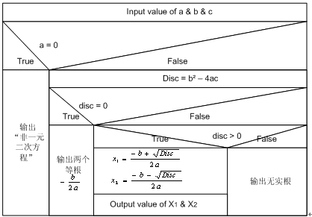
Flow chart

Slide 21
Program
#include<stdio.h>
#include<math.h>
int main()
{
int a,b,c ,disc; /*Declare variables */
double x1,x2;
printf("Input coefficients of the equation:\n");
scanf("a=%d,b=%d,c=%d",&a,&b,&c);
if(a==0) /*Linear equation*/
printf("Not a quadratic");
else
{
disc=b*b-4*a*c; /*Discriminant*/
….
}

Slide 22
Program_Contd
else /*Quadratic equation*/
{
disc=b*b-4*a*c;
if(disc==0) /* Two equal roots*/
printf("Two equal roots:%8.4f\n",-b/(2*a));
else
{
if(disc>0) /*Two distinct roots*/
{
x1=(-b+sqrt(disc))/(2*a);
x2=(-b-sqrt(disc))/(2*a);
printf("Distinct real roots:%8.4f and %8.4f\n”, x1,x2);
}
else /*Complex roots/
printf("No real roots\n");
}
}
return 0;
}

Slide 23
Else-if ladder
if (condition 1)
statement-1;
else if (condition 2)
statement-2;
else if (condition 3)
statement-3;
else if (condition n)
statement-n;
else
default-statement;
statement-x;
Notes:
going to be using similar variables but just in different ranges
you can have more than one else if if you would like

Slide 24
Flow Chart of else-if ladder
Entry
True
test condition 1
?
False
test condition 2
?
False
statement-1
True
test condition 3
?
False
statement-2
True
statement-3
True
test condition n
?
False
statement-n
default statement
statement-x
The else-if ladder runs more efficient than a set of nesting if-else(s).

Slide 25
if (number>500) cost=0.15;
else if(number>300) cost=0.10;
else if(number>100) cost=0.075;
else if(number>50) cost=0.05;
else cost=0;
if (grade>=90）
printf("A"); else if (grade>=80) printf(“B"); else if(grade>=70) printf(“C"); else if(grade>=60) printf(“D"); else printf(“F");

Slide 26
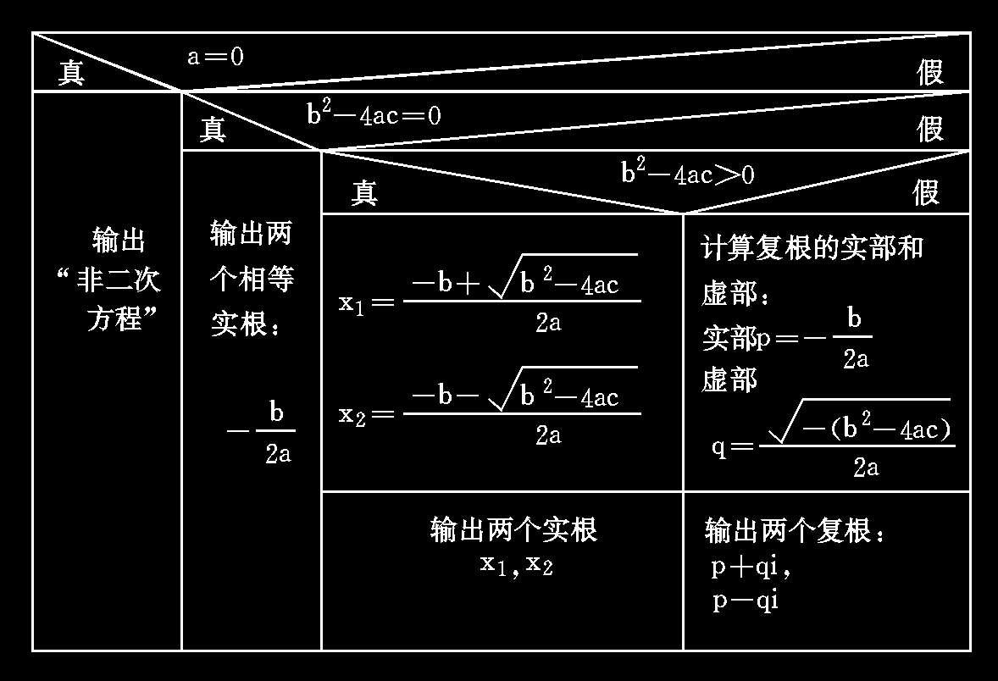
Exercise
Refine the program for quadratic equations by else-if ladder.

Slide 27
Else is always paired with the unpaired if statement above it in the most recent unified compound statement.
-1 (x<0)
例 4.3 有一个函数 y= 0 (x=0),编一程序，输入一个x
值，输出y值。 1 (x>0)
算法1： 算法2：
输入x 输入x
若x<0,则y=-1 若x<0,则y=-1
若x=0,则y=0 否则：
若x>0,则y=1 若x=0,则y=0
输出y 若x>0,则y=1
输出y

Slide 28
right？ error？
1： 2：
if(x<0) if(x>=0)
Y=-1; if(x>0) y=1;
else else y=0;
if (x= =0) y=0; else y=-1;
else y=1;
3: 4:
y=-1; y=0;
if(x!=0) if(x>=0)
if(x>0) y=1; if(x>0) y=1;
else y=0; else y=-1;
正
确
正
确
错
误
错
误
28

Slide 29
Switch statement
General form
switch (expression)
{
case value_1:
block_1；
break;
case value_2:
block_1；
break;
......
......
default:
default_block；
break;
}
statement_x;
Entry
switch expression
Expression==value_1
block1
Expression==value_2
block2
...
...
(no match) default
default block
statement-x
Notes:
I just wanted to clarify that switch is very similar to if
it's it's different in structure but it serves the same purpose right
so the purpose of a switch statement is to branch based on certain values
switch statements are easier to read when we're branching on some very clear variable
the curly braces similar to the body of an if statement but it's a little bit different because inside of these curly
braces what we're going to do is we're going to have different cases and the
cases are like the different value possibilities for this variable so for example we might have case 0 and then we
put a colon not a semicolon and then after the case 0 we can put the code of what happens if the value is 0 I'm just
going to put a comment code and then at the end of the case you use what's known as the break keyword
and this is a little odd but you have to put the break keyword and basically that says hey I'm done with cases zero we can
break out of this entire switch statement and proceed to whatever's after the switch statement then what you do is you can put the next case
so you could say case one and then you put the code and then you have a break so after every case you need to have this break keyword and it's vitally
once you've got all the cases written out you're going to have what's known as a default this is very similar to the else statement attached to an if statement and it works the same way and you even actually have to actually I don't know if it's required or not but you have to put in my rules so you have to put break at the end I don't think it's required but it's a good programming practice
every single case including the default needs to use that break keyword
now where do you put the code always right before the break so the code would go here
remember the default is going to catch if if none of these cases happen it's going to be like I catch all so this is the equivalent to the else statement of an if-elsif

Slide 30
#include <stdio.h>
int main(void){
int a;
printf("input integer number: ");
scanf("%d",&a);
switch (a){
case 1:printf("Monday\n"); break;
case 2:printf("Tuesday\n"); break;
case 3:printf("Wednesday\n"); break;
case 4:printf("Thursday\n"); break;
case 5:printf("Friday\n"); break;
case 6:printf("Saturday\n"); break;
case 7:printf("Sunday\n"); break;
default:printf("error\n");
}
return 0;
}
当switch后面括号内“表达式”的值与某个case后面的“常量表达式”的值相等时，就执行此case后面的语句。执行完一个case后面的语句后，流程控制转移到下一个case继续执行。如果你只想执行这一个case语句，不想执行其他case，那么就需要在这个case语句后面加上break，跳出switch语句。

Slide 31
Rules for switch statement
The switch expression must be an integral type including int, char and enum.
Case labels must be constants or constant expressions.
Case labels must be unique and end with semicolon.
The break statement transfers the control out of the switch statement. Set break upon demand.
只能针对基本数据类型中的整型类型使用switch，这些类型包括int、char等。对于其他类型，则必须使用if语句。
switch()的参数类型不能为实型 。
case标签必须是常量表达式(constantExpression)，如42或者'4'。
case标签必须是惟一性的表达式；也就是说，不允许两个case具有相同的值。

Slide 32
在case后的各常量表达式的值不能相同，否则会出现错误。
在case后，允许有多个语句，可以不用{ }括起来。
各case和default子句的先后顺序可以变动，而不会影响程序执行结果。
default子句可以省略不用。
When using a switch statement should also pay attention to the following:
in the case of the value of the constant expression cannot be the same, otherwise there will be a mistake.
After a case, multiple statements are allowed, which can be enclosed without {}.
The sequence of case and default clauses can be changed without affecting the execution of the program.
The default clause can be omitted.

Slide 33
#include<stdio.h>
int main()
{
char rank;
printf("请输入分数等级：(A、B、C、D、E)\n");
scanf("%c",&rank);
switch(rank)
{
case'A': printf("A(90~100)\n");break;
case'B': printf("B(80~89)\n");break;
case'C': printf("C(70~79)\n");break;
case'D': printf("D(60~69)\n");break;
case'E': printf("E(0~59)\n");break;
default: printf("error!\n");break;
}
}

Slide 34
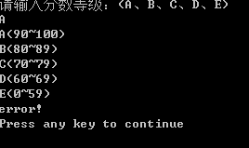
#include<stdio.h>
int main()
{
char rank;
printf("请输入分数等级：(A、B、C、D、E)\n");
scanf("%c",&rank);
switch(rank)
{
case'A': case'a': printf("A(90~100)\n");
case'B': printf("B(80~89)\n");
case'C': printf("C(70~79)\n");
case'D': printf("D(60~69)\n");
case'E': printf("E(0~59)\n");
default: printf("error!\n");
}
}

Slide 35
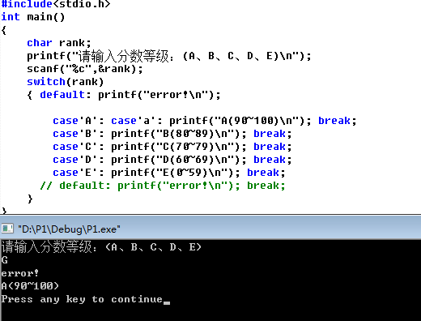

Slide 36
#include<stdio.h>
int main()
{
double score;
printf("请输入分数：\n");
scanf("%lf",&score);
switch((int)(score/10))
{
case 10:
case 9:printf("A(最好)\n");break;
case 8:printf("B(优秀)\n");break;
case 7:printf("C(良好)\n");break;
case 6:printf("D(及格)\n");break;
case 5:
case 4:
case 3:
case 2:
case 1:
case 0:printf("E(不及格)\n");break;
default:printf("Error!\n");
}
}

Slide 37
#include <stdio.h>
int main( )
{
double a, b;
char op;
scanf("%lf %c %lf", &a, &op, &b);
switch (op)
{
case '+':
printf("%lf + %lf = %lf\n", a, b, a + b); break;
case '-':
printf("%lf - %lf = %lf\n", a, b, a - b); break;
case '*':
printf("%lf * %lf = %lf\n", a, b, a * b); break;
case '/':
if (b != 0)
printf("%lf / %lf = %lf\n", a, b, a / b);
else
printf("除数不能是0! \n");
break;
}
return 0;
}

Slide 38
#include<stdio.h>
int main()
{
int year,month,date,leap,days = 0;
printf("请输入年份：");
scanf("%d",&year);
printf("请输入月份：");
scanf("%d",&month);
printf("请输入日：");
scanf("%d",&date);
leap=(year%4==0&&year%100!=0）||year%400==0;
switch(month)
{
case 12:days+=30;
case 11:days+=31;
case 10:days+=30;
case 9:days+=31;
case 8:days+=31;
case 7:days+=30;
case 6:days+=31;
case 5:days+=30;
case 4:days+=31;
case 3:days+=28+leap;
case 2:days+=31;
case 1:days+=date;break;
default:printf("data error");break;
}
printf("%4d年%2d月%2d日是这一年的第%d天。\n",year,month,date,days);
return 0;
}

Slide 39
Exercise-1
What is the numerical value of each of the following expressions?
5 > 2
3+4 > 2 && 3 < 2
x >= y || y > x
d = 5 + (6 > 2)
‘X’ > ‘T’? 10 : 5
x > y ? y > x : x > y

